Slide 1
Chandigarh University, Uttar Pradesh
B.Tech CSE
(Core + DS + CY + CC + IT)
Semester 3
Data Structure (25CSH-209)
Topic: Stack & its Operations, Applications
Faculty Name: Dr Sharad Nigam
(Assistant Professor)

Slide 2
Course Outcome (CO)
Sl. No. | Description | Bloom’s level*
CO1 | Understand and apply basic data structures, algorithms, complexity analysis, ADTs, arrays and linked lists. | Understand
CO2 | Apply and implement stacks and queues in problem solving. | Apply
CO3 | Analyze and apply searching, sorting, and hashing techniques. | Analyze
CO4 | Construct and apply tree structures and traversal techniques. | Evaluate
CO5 | Represent and solve graph problems using DFS, BFS, and graph algorithms. | Evaluate
 | PO1 | PO2 | PO3 | PO4 | PO5 | PO6 | PO7 | PO8 | PO9 | P10 | P11 | P12
CO1 | 3 | 3 | 3 | 3 | 3 | - | - | - | - | - | 1 | 1
CO2 | 3 | 3 | 3 | 3 | 3 | - | - | - | - | - | 1 | 1
CO3 | 3 | 3 | 2 | 3 | 3 | -- | - | - | - | - | 2 | 1
CO4 | 3 | 3 | 2 | 3 | 3 | - | - | - | - | - | 2 | 1
CO5 | 3 | 3 | 3 | 3 | 3 |  | - | - | - | - | 2 | 1

Slide 3
Table of Content
Stack
Stack Operations
Prefix and Postfix expressions

Slide 4
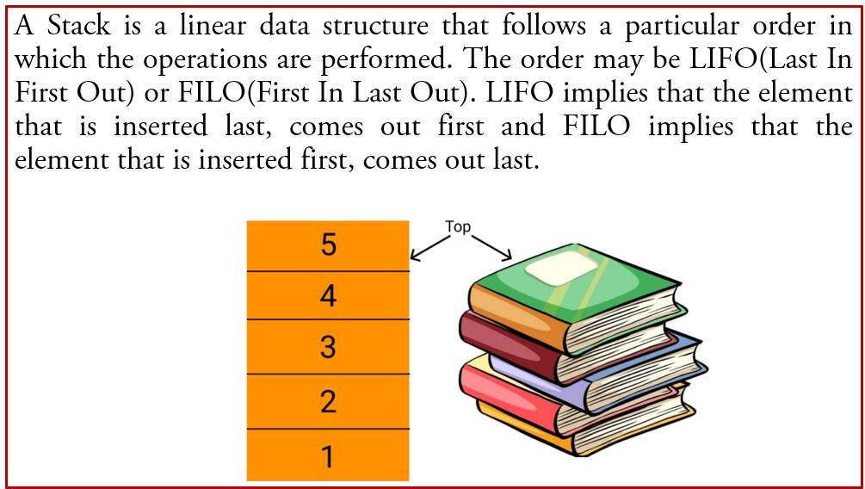
Stack

Slide 5
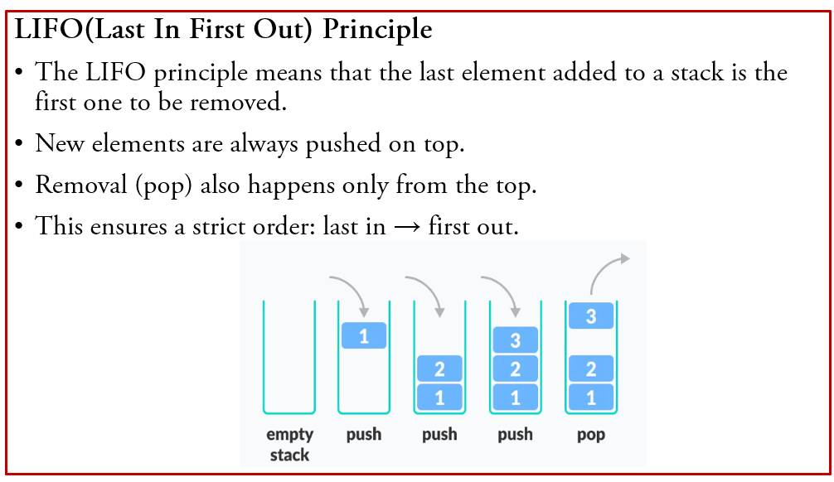
Stack

Slide 6
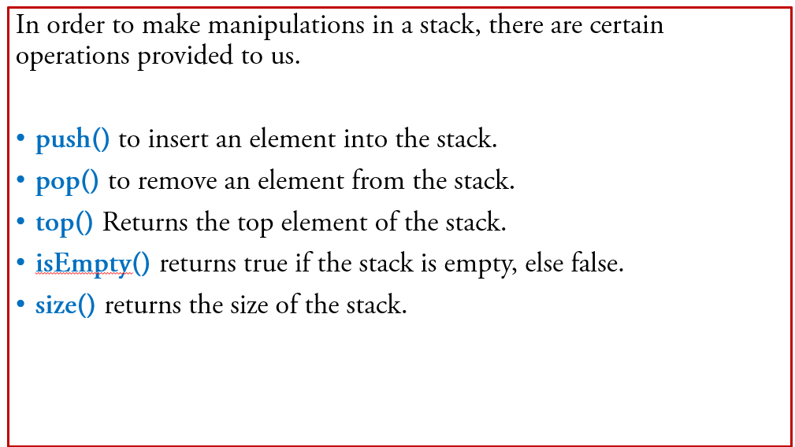
Circular Linked List

Slide 7
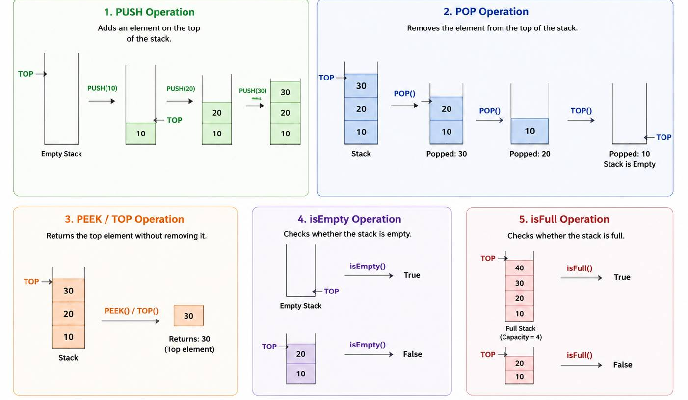
Stack Operations

Slide 8
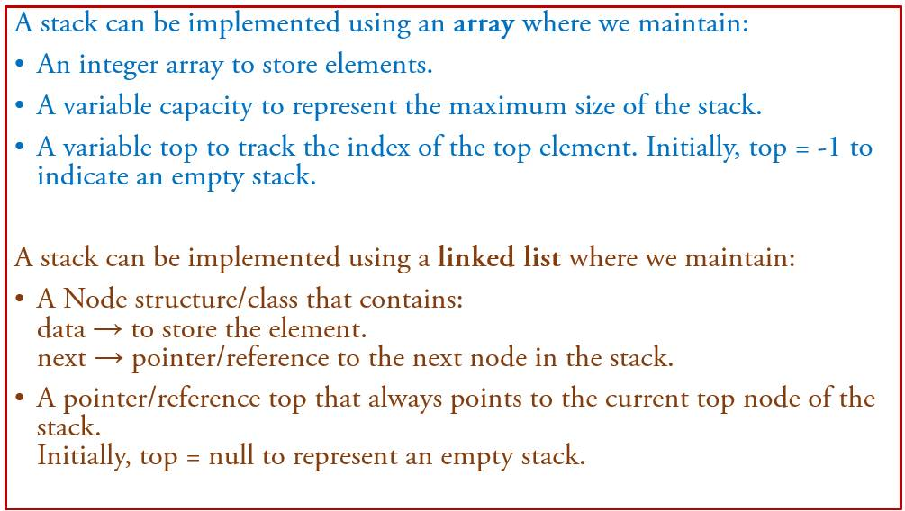
Stack Implementation

Slide 9
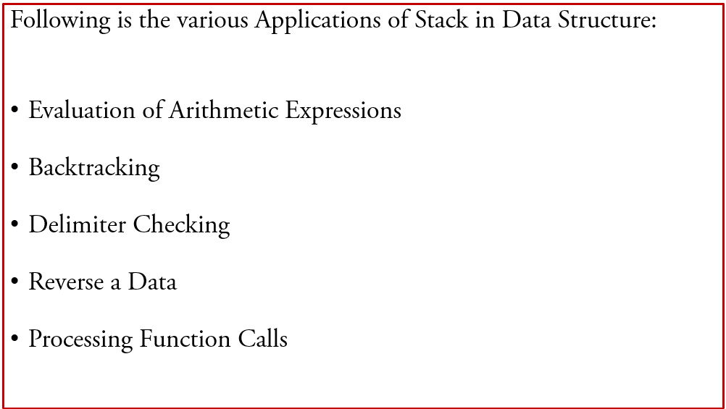
Stack Applications

Slide 10
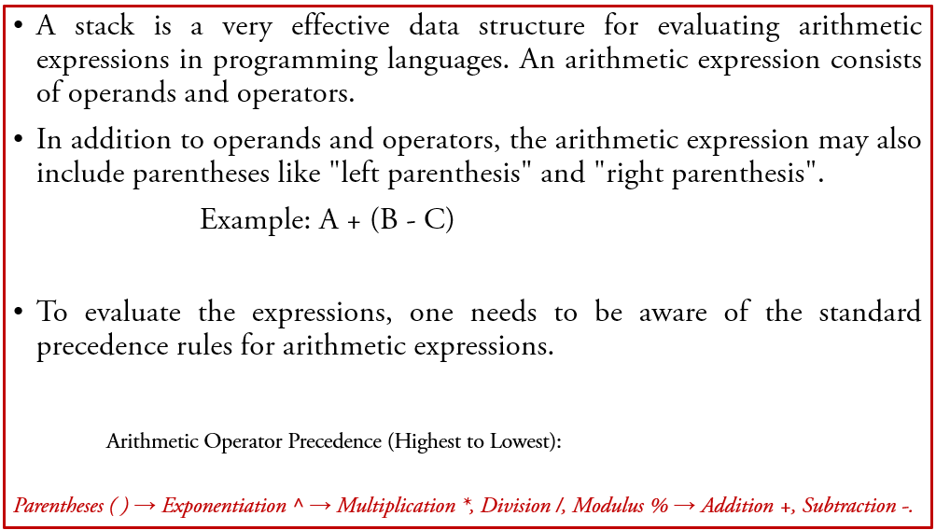
Evaluation of Arithmetic Expressions

Slide 11
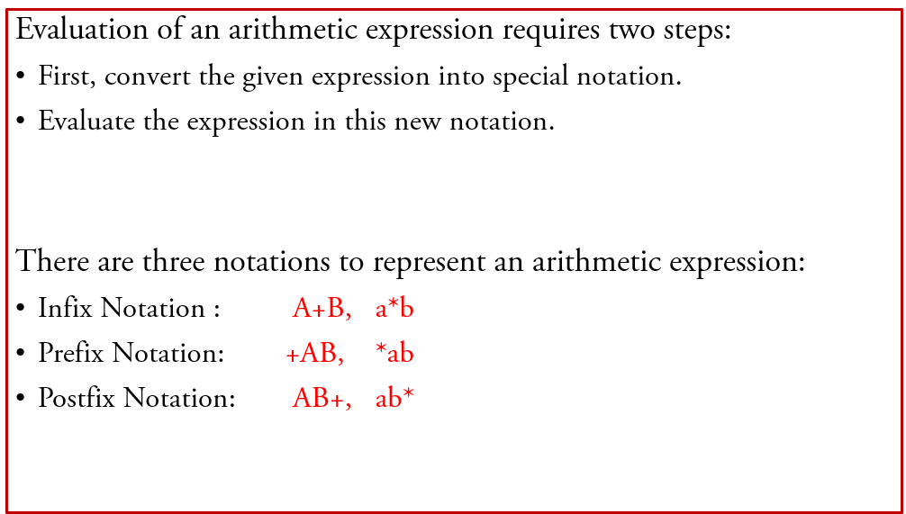
Evaluation of Arithmetic Expressions

Slide 12
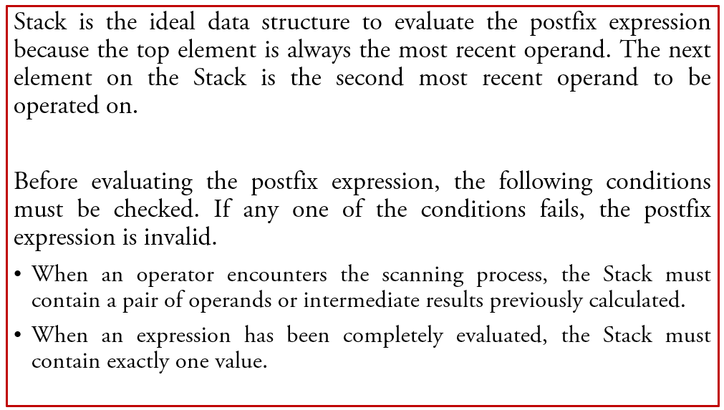
Evaluation of Postfix Expressions

Slide 13
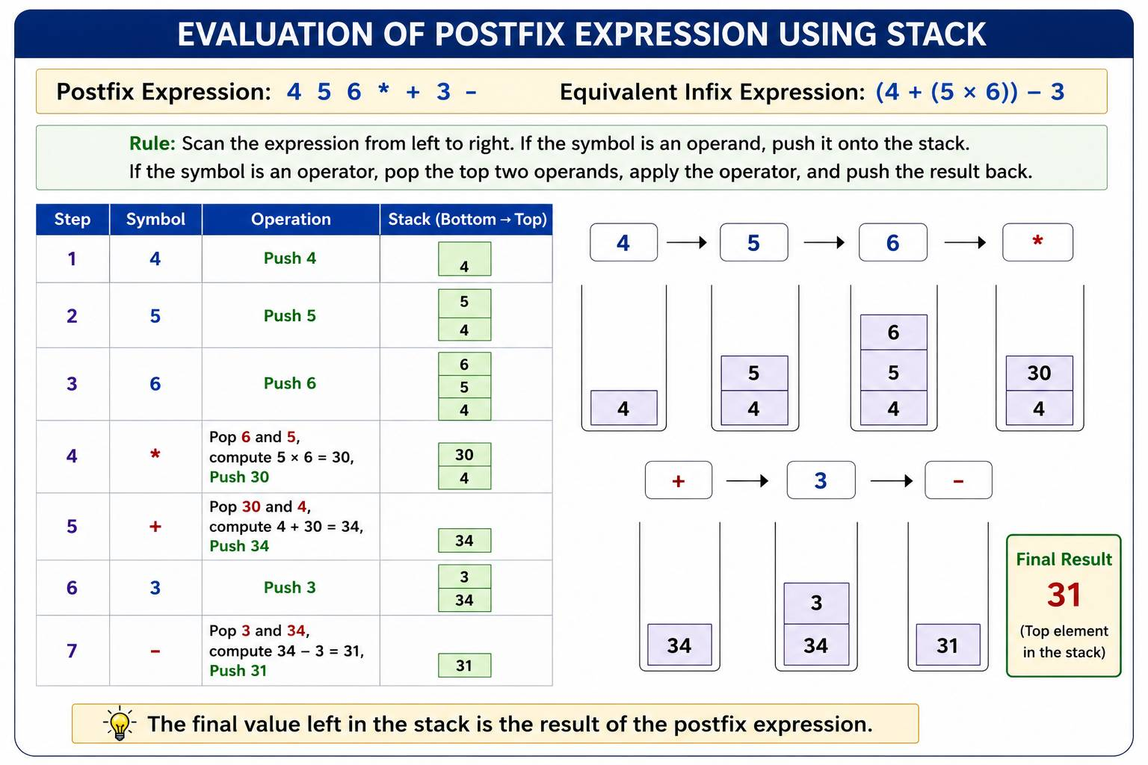

Slide 14
Reference
Goodrich, M. T., Tamassia, R., & Goldwasser, M. H. (2014). Data structures and algorithms in C++ (2nd ed.). Wiley.
Horowitz, E., Sahni, S., & Anderson-Freed, S. (2008). Fundamentals of data structures in C (2nd ed.). Universities Press.
Kruse, R. L., Leung, B. P., & Tondo, C. L. (2007). Data structures and program design in C (2nd ed.). Pearson Education.
Lipschutz, S. (2014). Schaum's outline of data structures with C (2nd ed.). McGraw-Hill Education.

